Slide 1
Hearing from the Holy Spirit
John Wilbur
Deeper in the Spirit Workshop
April 14, 2018

Slide 2
Introduction Hearing – Receiving – Following - Flowing

Slide 3
Hearing Don’t you realize that your body is the temple of the Holy Spirit, who lives in you and was given to you by God? You do not belong to yourself. 1 Corinthians 6:19 But the person who is joined to the Lord is one spirit with him. 1 Corinthians 6:17 So I say, let the Holy Spirit guide your lives. Then you won’t be doing what your sinful nature craves. Gal. 5:16 My lover said to me, “Rise up, my darling! Come away with me, my fair one! Song of Solomon 2:10

Slide 4
Suppressing Holy Spirit

Slide 5
1 Thessalonians 5:19-22 Do not stifle the Holy Spirit. Do not scoff at prophecies, but test everything that is said. Hold on to what is good. Stay away from every kind of evil. (NLT) Don’t suppress the Spirit, and don’t stifle those who have a word from the Master. On the other hand, don’t be gullible. Check out everything, and keep only what’s good. Throw out anything tainted with evil. (MSG)

Slide 6
Rejecting the words and works of the Holy Spirit because they are unfamiliar or uncomfortable to us suppresses, stifles and quenches the Spirit. Rejecting His gifts, wisdom and guidance stifles and grieves Him. Repentance of these actions is needed before you can move on. To begin hearing and experiencing all Holy Spirit has for you, make it right.

Slide 7
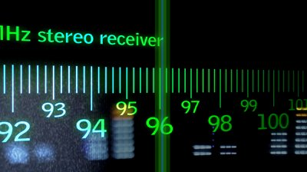
Tuning in
Since you have been raised to new life with Christ, set your sights on the realities of heaven, where Christ sits in the place of honor at God’s right hand. Think about the things of heaven, not the things of earth. For you died to this life, and your real life is hidden with Christ in God. Colossians 3:1-3

Slide 8
Place – Space - Pace

Slide 9
Guidelines for hearing from the Holy Spirit:
- Must be God-centered
- Must be Biblically accurate
- Must produce greater intimacy with Christ
- Must produce love, joy and peace (fruits of the Spirit)

Slide 10
Intentionally quiet your body, mind and spirit. Slow down and quiet down so you are able to hear the Holy Spirit.

Slide 11
Breathe slowly and deeply. As you breathe out, give your stress and worry over to Christ. As you breathe in, think on and take in His goodness, truth and peace.

Slide 12
Provide space for the Holy Spirit to speak. Invite Him to speak to you and quietly wait for Him.

Slide 13
Worshipful music, nature, etc may enhance your hearing, but don’t become dependent on it. Hearing can be done under less than ideal settings. It is a learned and practiced skill available to all believers.

Slide 14
Be aware that the Holy Spirit speaks in many various ways. These can include but are not limited to: visions, impressions, dreams, a clear voice, feelings of peace, comfort, conviction, gratefulness, wonder, love, being loved, the written word, etc.

Slide 15
As the Holy Spirit speaks, interact with Him. Ask the next question. Having these conversations with God lead to deeper understanding, intimacy, obedience and faith.

Slide 16
Reflect. Let it simmer for a while. Soak in what God did in you during your hearing from Him.

Slide 17
Thank Him. Never take for granted that the God who spoke all the galaxies into existence speaks to you individually.

Slide 18
Practice

Slide 19
Guidelines for hearing from the Holy Spirit:
- Must be God-centered
- Must be Biblically accurate
- Must produce greater intimacy with Christ
- Must produce love, joy and peace (fruits of the Spirit)

Slide 20
Filling up Be careful how you live. Don’t live like fools, but like those who are wise. Make the most of every opportunity in these evil days. Don’t act thoughtlessly, but understand what the Lord wants you to do. Don’t be drunk with wine, because that will ruin your life. Instead, be filled with the Holy Spirit, singing psalms and hymns and spiritual songs among yourselves, and making music to the Lord in your hearts. And give thanks for everything to God the Father in the name of our Lord Jesus Christ. Ephesians 5:11-20

Slide 21
The Holy Spirit within you must be fed

Slide 22
The Holy Spirit within you must be heard

Slide 23
The Holy Spirit within you must be followed

Slide 24
Living by the Spirit’s power Those who belong to Christ Jesus have nailed the passions and desires of their sinful nature to his cross and crucified them there. Since we are living by the Spirit, let us follow the Spirit’s leading in every part of our lives. Galatians 5:24-25 We are destroying speculations (wrong thinking or reasoning) and every lofty thing raised up against the knowledge of God, and we are taking (daily battle) every thought captive (Military term – continually taking captive) to the obedience of Christ (this is the end result) 2 Corinthians 10:5

Slide 25
Practice

Slide 26
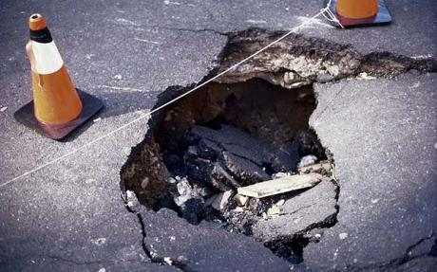
Potholes in hearing from the Holy Spirit

Slide 27
Trying too hard How foolish can you be? After starting your new lives in the Spirit, why are you now trying to become perfect by your own human effort? Galatians 3:3

Slide 28
Legalism Leash So Christ has truly set us free. Now make sure that you stay free, and don’t get tied up again in slavery to the law. Galatians 5:1

Slide 29
Making it weird My lover said to me, “Rise up, my darling! Come away with me, my fair one! Song of Solomon 2:10 Look! I stand at the door and knock. If you hear my voice and open the door, I will come in, and we will share a meal together as friends. Rev. 3:20

Slide 30
Anyone who believes in me may come and drink! For the Scriptures declare, ‘Rivers of living water will flow from his heart.’”(When he said “living water,” he was speaking of the Spirit, who would be given to everyone believing in him.) John 7:38, 39

Slide 31
¹¹ “You fathers—if your children ask for a fish, do you give them a snake instead? ¹² Or if they ask for an egg, do you give them a scorpion? Of course not! ¹³ So if you sinful people know how to give good gifts to your children, how much more will your heavenly Father give the Holy Spirit to those who ask him.” Luke 11:11-13

Slide 32
Practice flowing

Slide 33
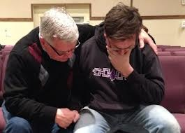
Hearing for others

Slide 34
Be a pipeline, not a DJ.

Slide 35
Practice

Slide 36
Feedback & questions

Slide 37
Walking it out

